Slide 1

Git & GitHub
The room for controlling your development

Slide 2
Git Workflows “Committing Files”:
Git maintains three snapshots of a file in separate directories
The Dir where the command init executed
Now the file are tracked and ready for committing
Working Directory
Staging Area
Adding files and changes using <git add .>
This is the main steps you do in each update in the repo. The updates may be just adding one line in a file you need to add them to staging then commit this update.
commit changes using <git commit –m “msg” >
Always check <git status>
Local Repository

Slide 3
Collaborating between local and remote Repos
Local Repo
Remote Repo
Local Repo
C1
C2
C3
.
.
.
C1
C2
C3
.
.
.
C1
C2
C3
.
.
.
< git push origin master >
< git pull origin master >
< git pull origin master >
< git push origin master >
C5
C5
C5

Slide 4
git clone vs. git pull:
Aspect | git clone | git pull
When to use | First time getting the project | Keeping your local copy up to date
Requires repo? | No, it creates a new local repo | Yes, needs an existing local repo with a remote set
What it does | Copies entire history, files, branches, remotes | Fetches new commits from remote and merges into current branch
Frequency | Usually once per machine per repository | Many times, during normal development workflow

Slide 5
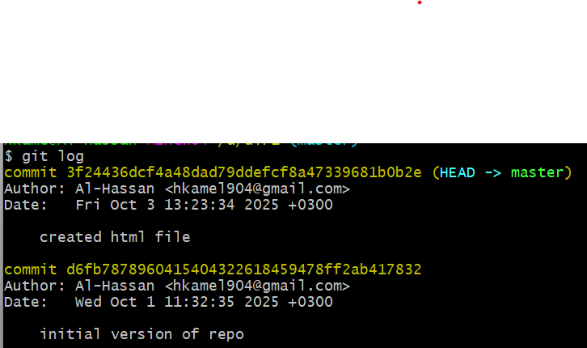

Traverse between different commits:
To show previous commits of the repository (changes you have made): < git log > To restrict the output to one line: < git log –oneline >
The commit hash code
Tracking file changes is the ability to identify changes between the different versions of the same file, spread across various repositories.

Slide 6
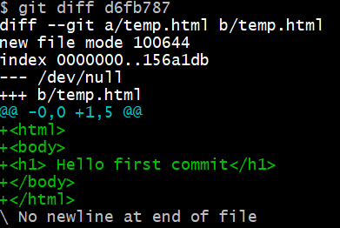
Traverse between different commits:
Working Directory
Staging Area
Local Repository
Commit1 <= HeaD1
Commit2 <= HeaD2
< git add . >
< git commit >
< git log >
To get the differences between different commits in other words what happened from the previous commit to the current one: < git diff file_name || git diff commit_hashcode >
Nothing will be shown if the two versions of the file are the same

Slide 7


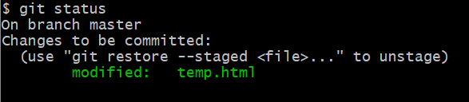

Traverse between different commits:
< git log >
List the details of the commit including the commit hash code associated with the file
< git checkout “commit_hash_code” “file_name” >
Stages the file and reverts it to the specified version
< git status >
< git commit –m “msg” >
< git reset >
Save a new version
Delete the file from the staging area
< git reset –hard hashCode >
All commits that were after it on this branch become “lost” from that branch

Slide 8
Branching:
It helps in reducing the errors & protecting the contents of the main (master) repository.
Separate workspace: used to experiment or test something without impact the main codebase.
3
4
Manage releases
1
2
3
4
5
Main code base
Create hot fixes to the production branches
4
5
When a new branch is created, the complete commit history of the master branch is replicated
A Git branch is just a pointer to the commit; it doesn’t change the content of the repository.

Slide 9


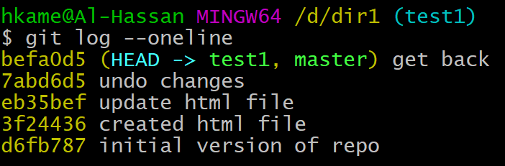
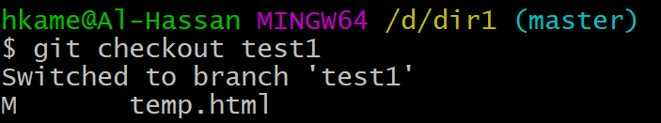
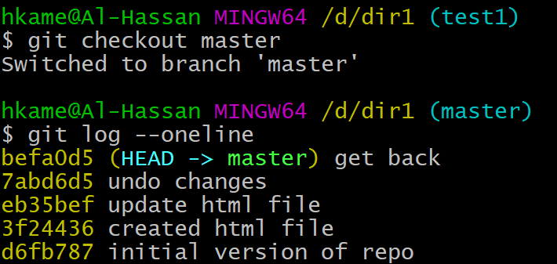
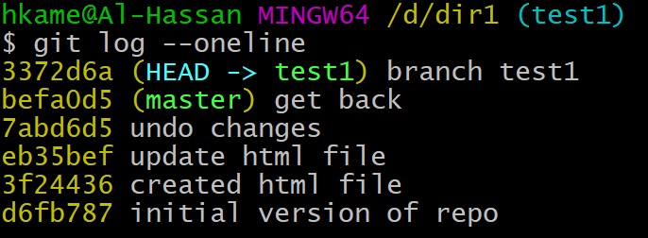
Branching:

Slide 10
Merging:
The commits of one branch are only visible to that branch; other branches are still untouched, i.e., the branches’ commit history doesn’t include the commits of other branches.
Thus, if you push that branch, it creates a new branch in GitHub with its own changes.
To see all the commits of the whole repo, including other branches commits use the command: < git log –oneline –graph –all >
Branch merging is how Git combines the work from one branch into another, so their histories come back together. Once you are sure about your changes!!!
Fast Forward Merge | Merge (Non-Fast Forward)
Happens when main has not moved since feature-branch was created. | Happens when both branches have new commits.
History is linear, no extra merge commit. | creates a new merge commit with two parents to join the histories.

Slide 11
Merge Branches:
Fast Forward Merge
Non-Fast Forward Merge (Three-way)
3
4
3
4
1
2
3
3*
4
5
1
2
3
4
git merge b1
git merge b1 –m “merge branch.”
Conflicts happen when both branches changed the same lines or nearby lines in a file.
After manual fix + git add, the merge commit records the resolved result.
b1
git merge b1
3
4
1
2
3
4
3*
4*
5
3
4
b2
git merge b2

Slide 12
Resources:
https://youtube.com/playlist?list=PLDoPjvoNmBAw4eOj58MZPakHjaO3frVMF&si=sWBFhTCTo3VRZgRR
https://youtube.com/playlist?list=PL-osiE80TeTuRUfjRe54Eea17-YfnOOAx&si=rK49ZuLMdGnXnq6c

